Slide 1
3.State: Origin &Function
For By
B.A. (Pol.Sc.(Hons.) G K Jha
Degree Part-I, Paper-I Asst. Prof.
Deptt. Of Pol. Sc.
Marwari College,Darbhanga

Slide 2
Idea of State
So far we have understood as to what is state and what it does. It is pertinent to as under what conditions state originated and what it really dies to us. It is a well known fact that State is a modern idea but its traces can be found in almost all civilizations in mythical as well as epistemological form.
Today we’re going to chart a different terrain to understand the background of the origin of state by conveniently discussing some of the important theories on it.

Slide 3
Theories
Divine origin theory;
Force Theory;
Patriarchal Theory;
Matriarchal Theory;
Social Contract Theory;
Historical/Evolutionary theory; and
Marxist Theory

Slide 4
Divine Origin/Right Theory
The State, its advocates maintain was created by God and governed by His deputy or vicegerent.
He (God) sent His deputy to rule over them.
The ruler was a divinely appointed agent and he was responsible for his actions to God alone.
As the ruler was the deputy of God, obedience to him was held to be a religious duty and resistance a sin.

Slide 5
Divine right theory…
Nobody could limit his will and restrict his power.
His word was law and his actions were always just and benevolent.
To complain against the authority of the ruler and to characterize his actions as unjust was a sin for which there was divine punishment.

Slide 6
Evaluation
This theory is so enunciated, believed in and accepted, thus, implied:
i) That God deliberately created the State and this specific act of His grace was to save mankind from destruction.
ii) God sent his Deputy or Vice-regent to rule over mankind.

Slide 7
Criticism
The divine rights of kings /Monarchy is divinely ordained and the King draws his authority from God.
Monarchy is hereditary and it is the divine right of a King that it should pass from father to son.
The King is answerable to God alone and resistance to the lawful authority of a King is a sin

Slide 8
Force Theory
It emphasizes the origin of the State in the subordination of the weak to the strong.
A person physically stronger can capture and enslaved the weak. Having increased the number of his followers, over whom he exercised undisputed authority, he became a tribal chief.

Slide 9
Force Theory…
The powerful conquered the weak - this process of conquest and domination continued till the victorious tribe secured control over a definite territory.
Implications Of The Theory Of Force:
I) Force is not only a historical factor, but is present essential feature of the State
ii) The States were born of force only

Slide 10
Force Theory
iii) Power is their justification and raison d'être
iv) The maintenance and extension of power within and without is the sole aim of the State.

Slide 11
Social Contract Theory
It postulates a state of nature as the original conditions mankind and
The state of nature was not an organized society. Each man living therein led a life of his own, uncontrolled by any laws of human imposition.
Social Contract is a Voluntary agreement made amongst individuals through which an organized society, or State, is brought into existence.
Hobbes, Locke Rousseau as original thinkers and revived by John Rawls in modern times.

Slide 12
Elements of Social Contract Theory
The image of a hypothetical stateless society,i.e. a state of nature is established. Unconstrained freedom means that life is ‘solitary, poor, nasty, brutish and short’.
Individuals therefore seek to escape from the state of nature by entering into a social contract, recognizing that only a sovereign power can secure order and stability.
The social contract obliges citizens to respect and obey the state, ultimately in gratitude for the stability and security that only a system of political rule can deliver.

Slide 13
Thomas Hobbes(1588-1679)
An English Philosopher, who subsequently became tutor of the Cavendish family. Writing at a time of uncertainty and civil strife, precipitated by English Revolution, Hobbes developed the first comprehensive theory of nature and human behaviour since Aristotle.
His classic work Leviathan(1651) discussed the grounds of political obligation and provided a defence for absolutist government.

Slide 14
Thomas Hobbes
The State of Nature: characterized as the pre-social phase of human nature “the liberty that each man has to use his own power for the preservation of his own nature.” Man not at all social, indeed “nothing but grief in the company of his fellows”- all being almost equally selfish, self- seeking, egoistic, brutal and aggressive.
The Contract: Agreed to surrender their natural rights into the hands of common superior and to obey his commands. A contract binding each and all to unquestioning obedience to a sovereign could really establish a stable commonwealth.

Slide 15
John Locke
The State of Nature: It was pre-political and not pre-social Man was neither selfish, nor self- seeking, nor aggressive. Men were equal and free to act they thought fit, but within the bounds of the law of nature.
Need for Civil Society According to Locke, this “ill condition” was due to three important wants which remained unsatisfied in the state of nature: i) The want of an established, settled, known law ii) The want of a known and indifferent judge, and iii) The want of an executing power to enforce just decisions.

Slide 16
Locke…
The social contract was no more than a transfer of certain rights and powers so that man’s remaining rights would be protected and preserved. The contract was for limited and specific purposes and what was given up was transferred to the community as a whole and not to a man or to a assembly of men.
Two Contracts:
i) A Social Contract which brought into being the civil society or the State.
ii) A governmental contract when society in its corporate capacity established a government and selected a ruler to remove the inconveniences, which necessitates the formation of the civil society or the State.
Locke recognized the existence of 3 powers in the civil society or the State: legislative, executive and federative.

Slide 17
Jean Jacques Rousseau(1712-78)
The State of Nature: man in this state of nature was a “noble savage” who led a life of primitive simplicity and idyllic happiness. He was independent, contented, self- sufficient, healthy, and fearless and “without need of his fellows or desire to harm them.”
Emergence of Civil Society: individuals became a collective unity – a society “puts his person and all his power in common under the supreme direction of the general will and in our corporate capacity we receive each member as an indivisible part of the whole.”
General Will: only one contract - social and political The individual surrendered himself completely and unconditionally to the will of the body of which he became a member. The body so created was a moral and collective body and Rousseau called it the General Will.
The unique feature of the General Will: It represented collective good as distinguished from the private interests of its members. It was the will of all the citizens when they were willing not their own private but the general good. all citizens willing the best interests of the community and its lasting welfare, it must it must be sovereign.

Slide 18
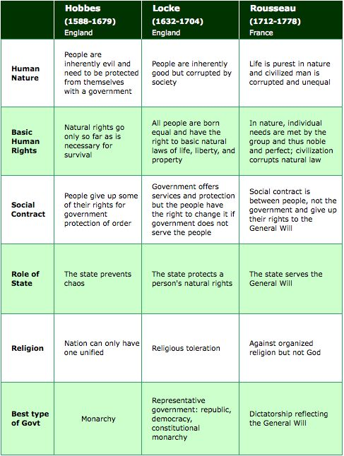

Slide 19
General Will- the genuine interest of a collective body, equivalent to the common good; the will of all, provided each person acts selflessly.
Rousseau's writing(Emile and The Social Contract) reflect a deep belief in the goodness of ‘natural’ men and the corruption of ‘Social Men”.

Slide 20
Patriarchal Theory
Patriarchy literally means ‘rule by the father'. The domination of husband-father within the family, and the subordination of his wife and children. However in general sense the term is used to denote the ‘rule by men’, drawing attention to the totality of oppression and exploitation to which women are subjects. It is a key concept in radical Feminist analysis,tn that it emphasizes that gender inequality is systematic, institutionalized and pervasive.

Slide 21
Patriarchal Theory…
State is an enlargement of the family. Originally, the family consisted of a man, his wife and children. The father was the head of the family and his control and authority was complete in all respects over all its members.
When his children married there was expansion in the original family and it led to the establishment of new families. But the authority of the father and head of the original family remained unabated as before all lived and functioned under the recognized authority of the senior living male member of the original family.
With the lapse of time many members withdrew from the parent tribe and settled in new lands in search of their living. SIR HENRY MAINE’S is the original proponent f this theory.

Slide 22
Matriarchal Theory
Mc Lennan, Jenks and Morgan are the notable exponents of the Matriarchal Theory.
They reject outright the proposition that the patriarchal family was the earliest form of society. Kinship could only be traced through mother, matriarch.
The advocates of this theory maintain that patriarchal family is possible where either the monogamous or the polygamous institution of marriage exists. The earliest form of marriage was polyandry, one wife having several husbands.
“the credit of having discovered the clan, a maternally organized, hereditary and unilateral unit, unilateral because children traded this system belonged to the clan of their mother, without regard to the clan of their father.”

Slide 23
Historical or Evolutionary theory
It explains that the State is the product of growth, a slow and steady evolution extending over a long period of time and shaping itself into the complex structure of a modern State.
Important Factors of rise and growth of the State: i) Kinship ii) Religion iii) Property and Defense iv) Force v) Political Consciousness.

Slide 24
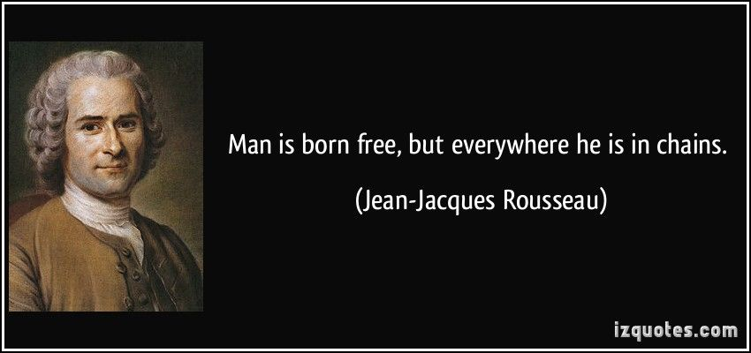
In lieu of conclusion…

